Slide 1


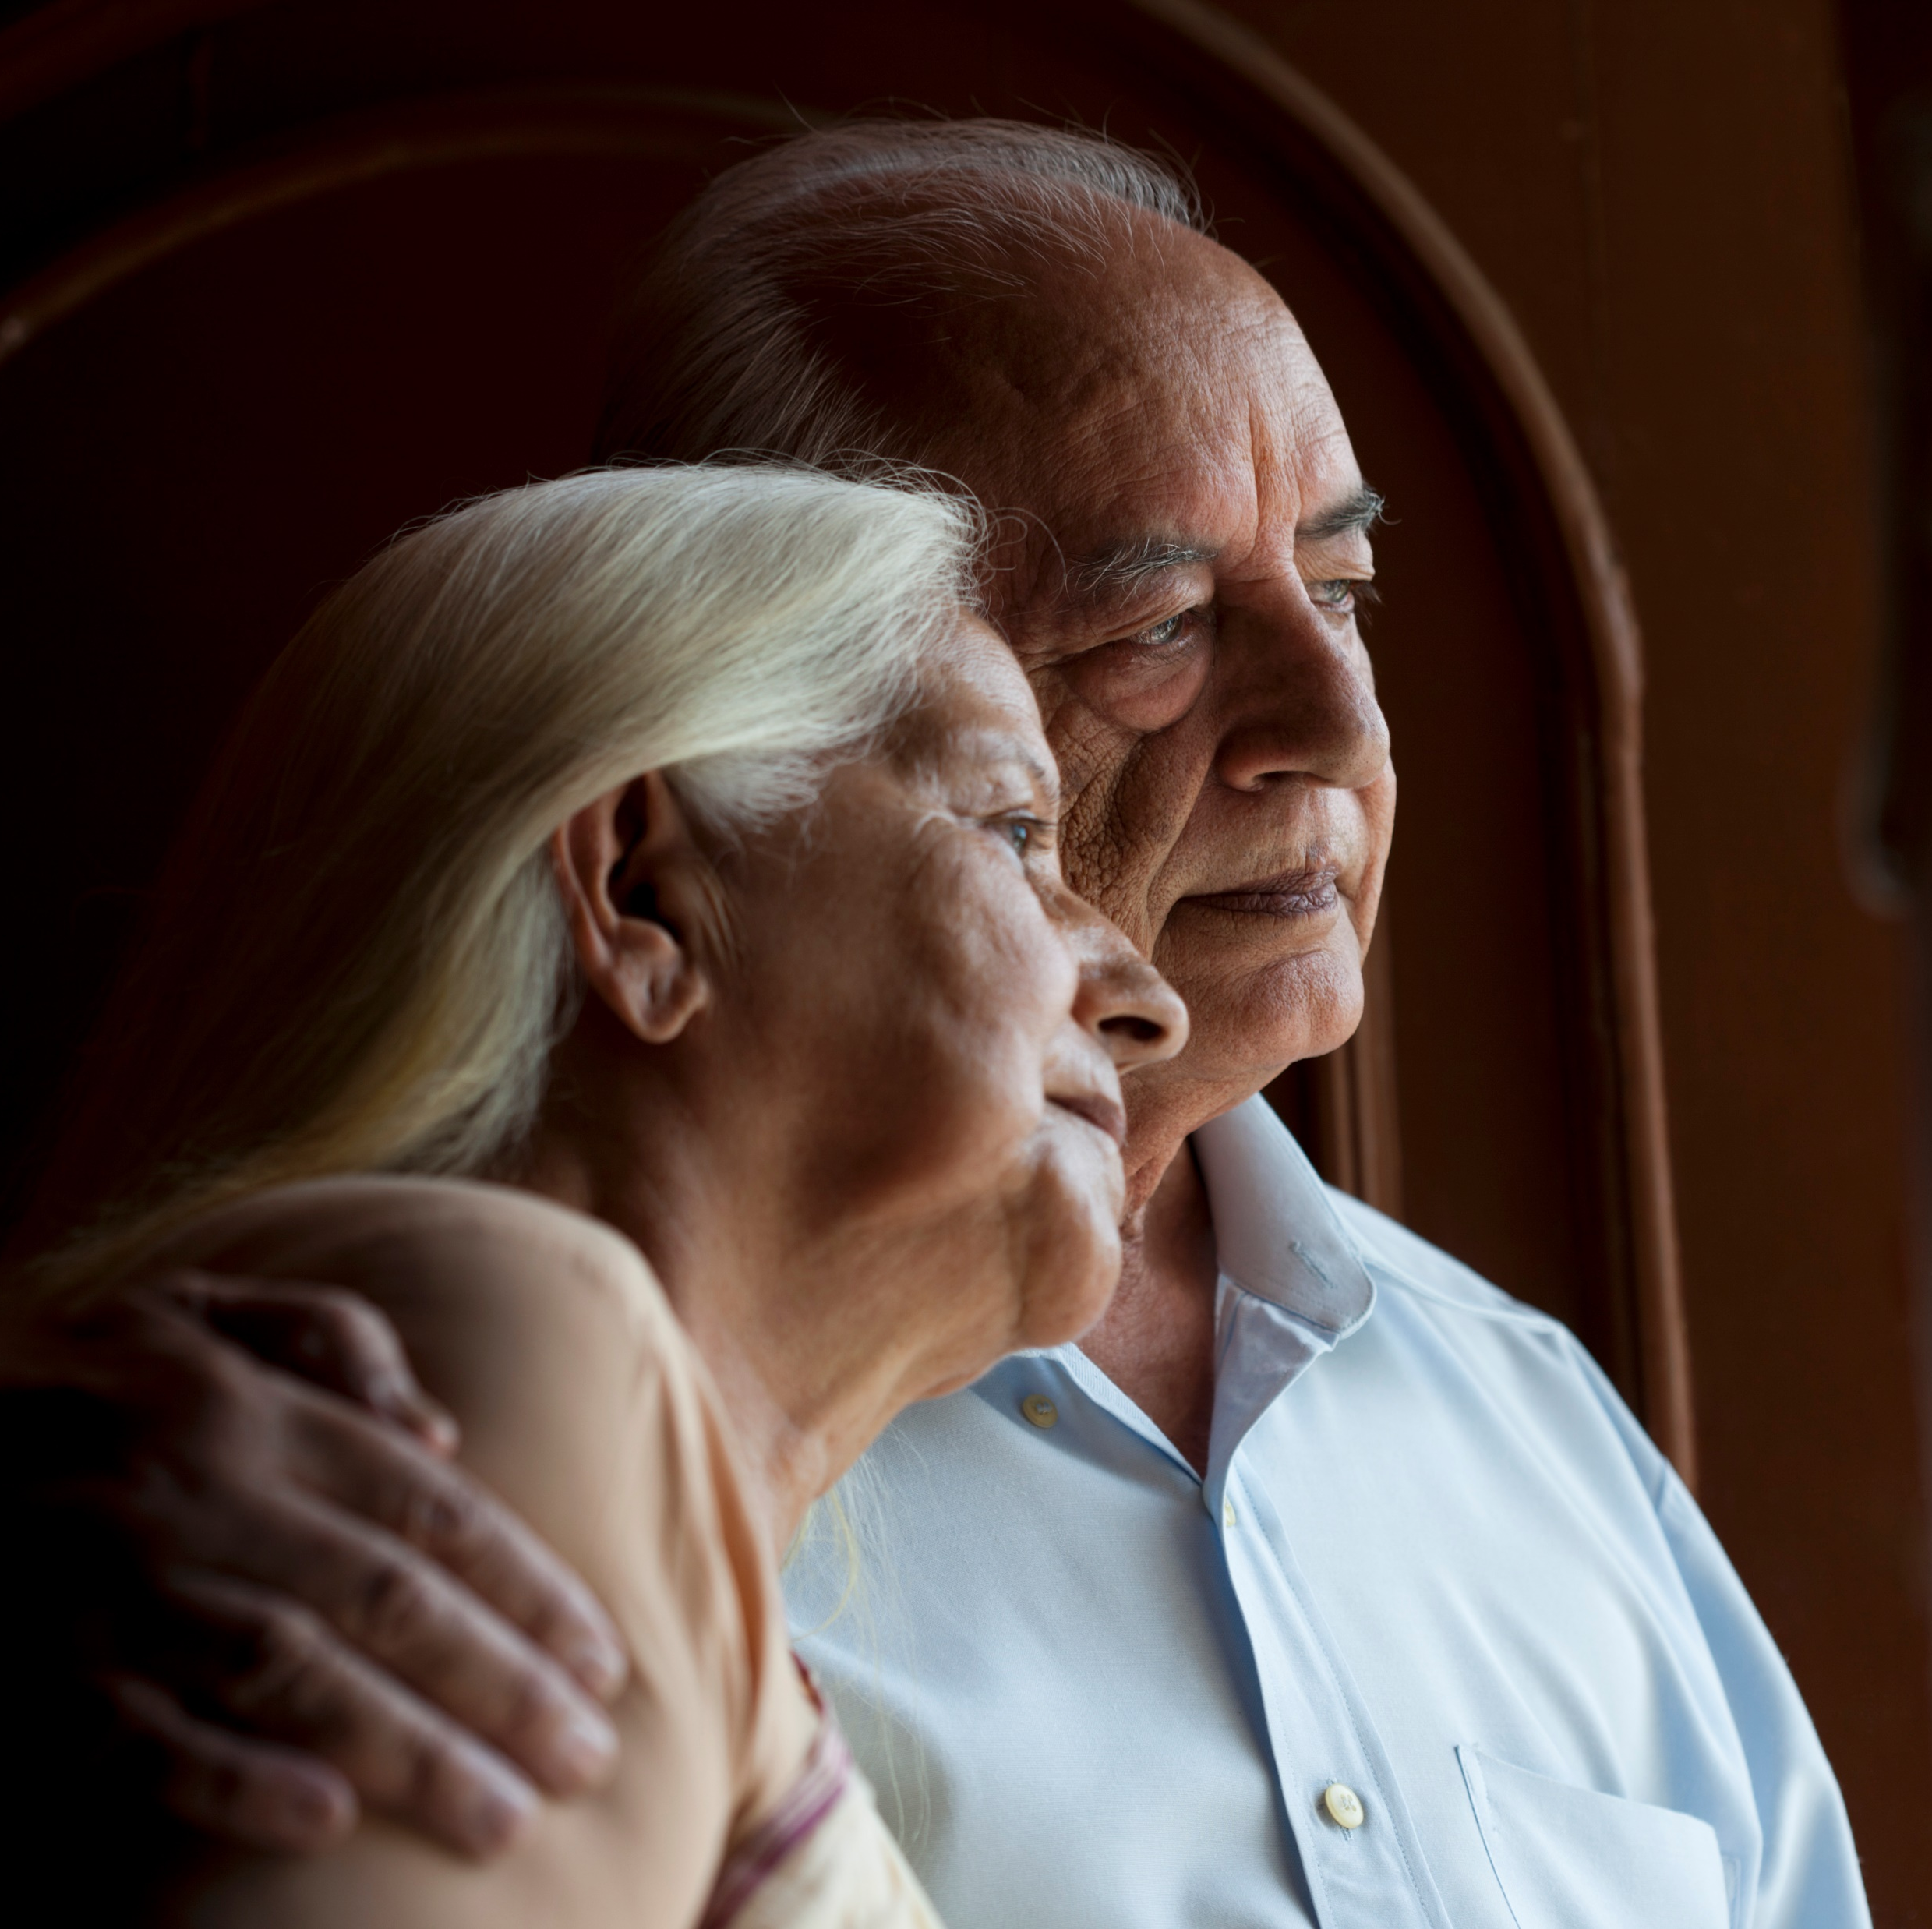

The Soul in the Circuit:
Weaving Humanity into Tomorrow’s Care.
Professor Donald Macaskill
CEO, Scottish Care
11th March 2026

Slide 2

“The soul in the circuit”
11th March 2026

Slide 3

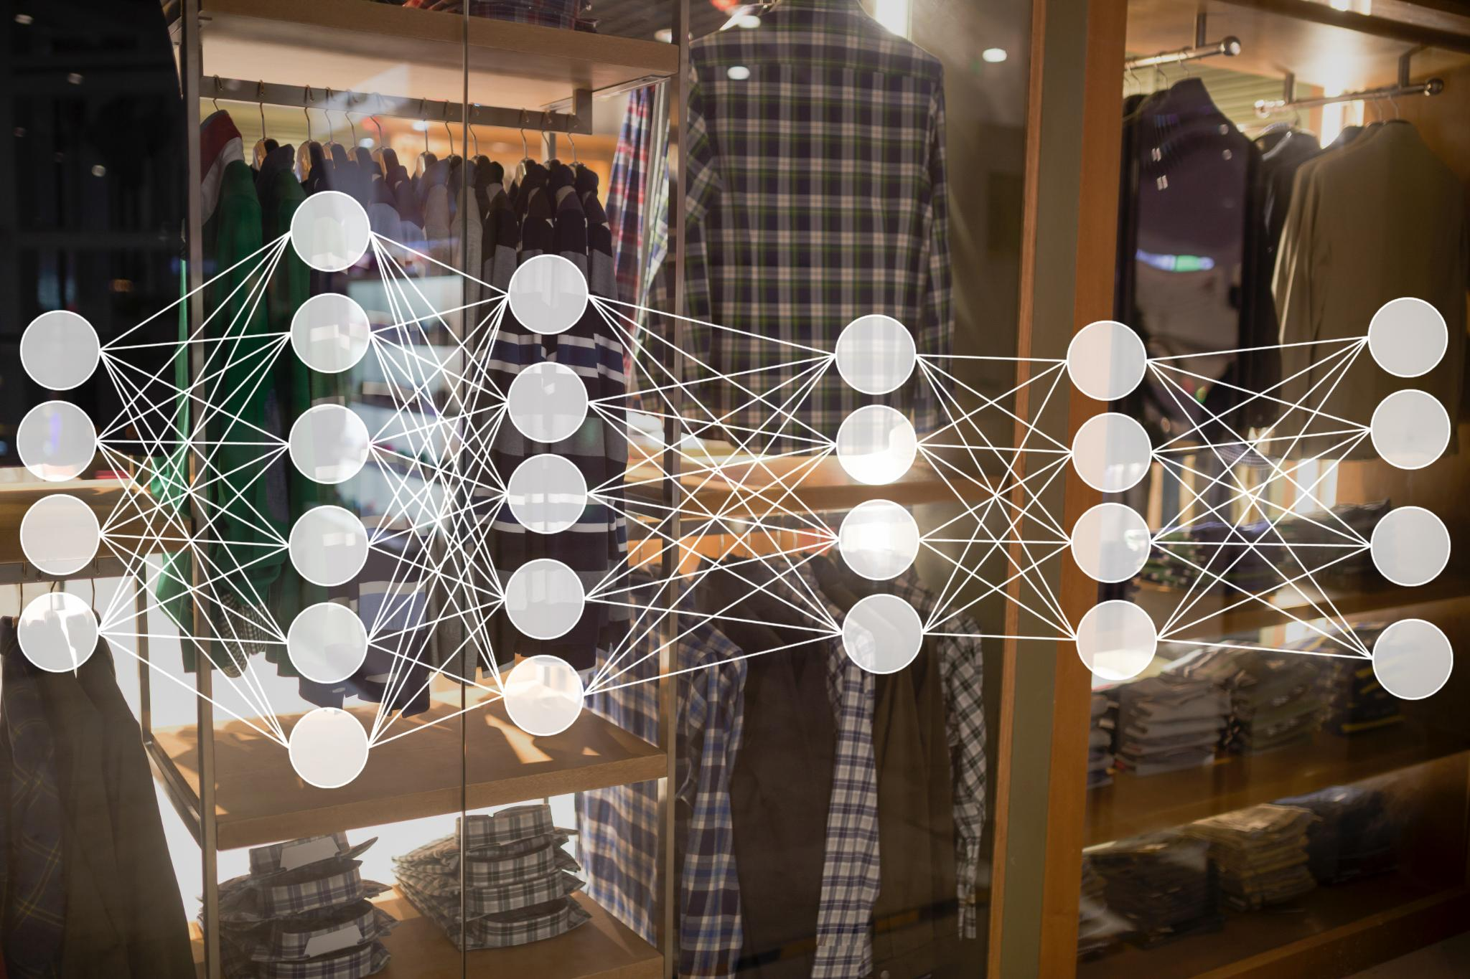
Global retail and agentic Ai
searches,
compares,
validates,
builds baskets,
completes purchases
— sometimes without the human ever asking directly.
11th March 2026

Slide 4

The changing consumer
They want meaningful relevance. Not a flood of information, but a flow of respect. Not bombardment, but anticipation. Not intrusion, but understanding.
AI systems build subtle psychological profiles, micro‑signals, timing rhythms –
So retail is shifting toward anticipatory systems: AI that predicts need before need is spoken.
11th March 2026

Slide 5


The omniconsumer.
Retail is not only evolving personalisation; it is dissolving the idea of channels altogether. You are not a user of a platform - you are the platform. Everything flows around you. You become the pivot, the context, the centre point.
11th March 2026

Slide 6

W(h)olistic Ai in care
Retail’s omniconsumer is simply a commercial metaphor for what we in care have known for generations:
A person’s life is not a set of disconnected episodes - it is a whole, living, relational story.
And AI allows us, perhaps for the first time, to coordinate care in a way that honours that wholeness.
11th March 2026

Slide 7

But with this immense capability comes risk.
We could see:
erosion of autonomy,
opaque decision-making,
surveillance without consent,
systems that infantilise rather than empower,
a loss of the right to “be” rather than be managed.
11th March 2026

Slide 8
PANEL
Participation,
Accountability,
Non discrimination,
Empowerment, and
Legality.
11th March 2026

Slide 9
Participation
The older person, the individual receiving care, must shape the technology, not simply be shaped by it.
They must be co‑creators.
Accountability
AI cannot become an unchallengeable oracle. Decisions must be explainable. Systems must be transparent.
Non discrimination
AI inherits the bias of the data it is trained on.
If we do not build inclusively, AI will magnify inequality.
11th March 2026

Slide 10
Empowerment
It must help someone to live the life they want, not the life a system predicts for them. It must create capability, not dependency; confidence, not compliance.
Legality
AI inherits the bias of the data it is trained on.
If we do not build inclusively, AI will magnify inequality.
11th March 2026

Slide 11
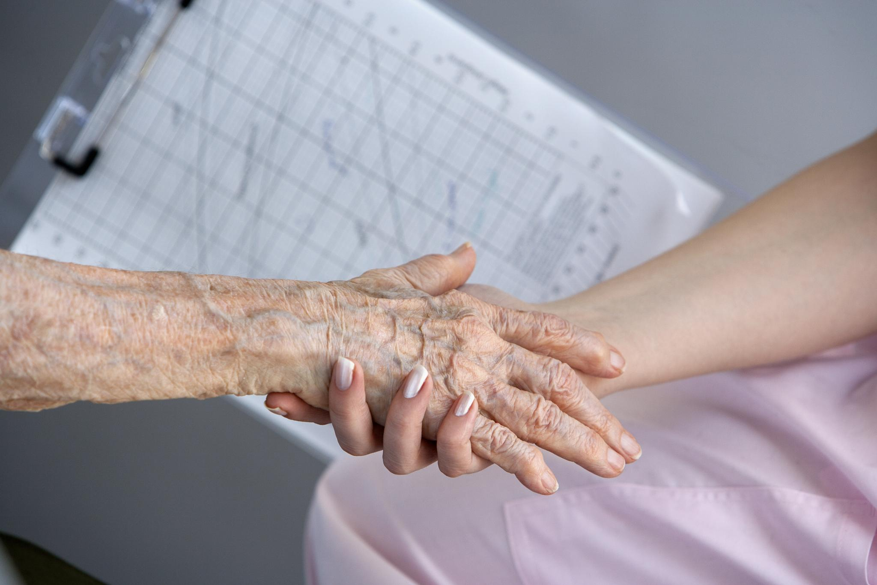
The measure of success in AI in care is not efficiency. It is human connection
If AI deepens relationship, strengthens autonomy, widens possibility, and restores dignity - then it is ethical.
If it replaces presence, narrows choice, or fragments relationship - then it is not.
We stand at a moral threshold. Not simply a technological one.
11th March 2026

Slide 12

The soul in the circuit
The soul is not in the machine.
The soul is in the intention.
The soul is in the relationship.
The soul is in the choice to design with dignity, to govern with humility, to innovate with compassion.
11th March 2026

Slide 13

Thank you
donald.macaskil@scottishcare.org
@DrDMacaskill
11th March 2026

