Slide 1
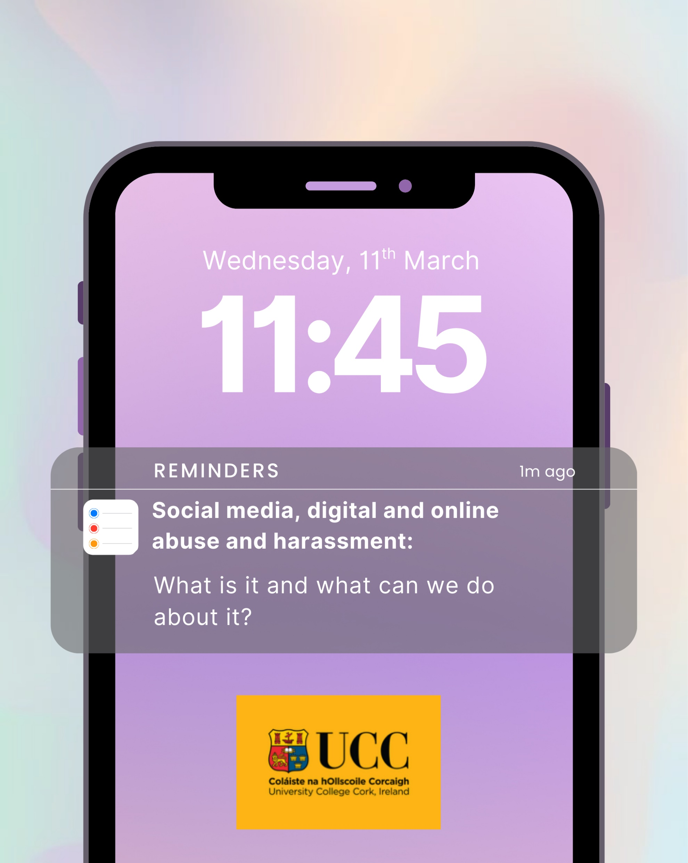
Kenneth Burns, Olwen Halvey,
Fiachra Ó Súilleabháin and
Amy Bradley
Notes:
Introduce the team.
Appreciative of the support and funding we have received from the CFA.

Slide 2
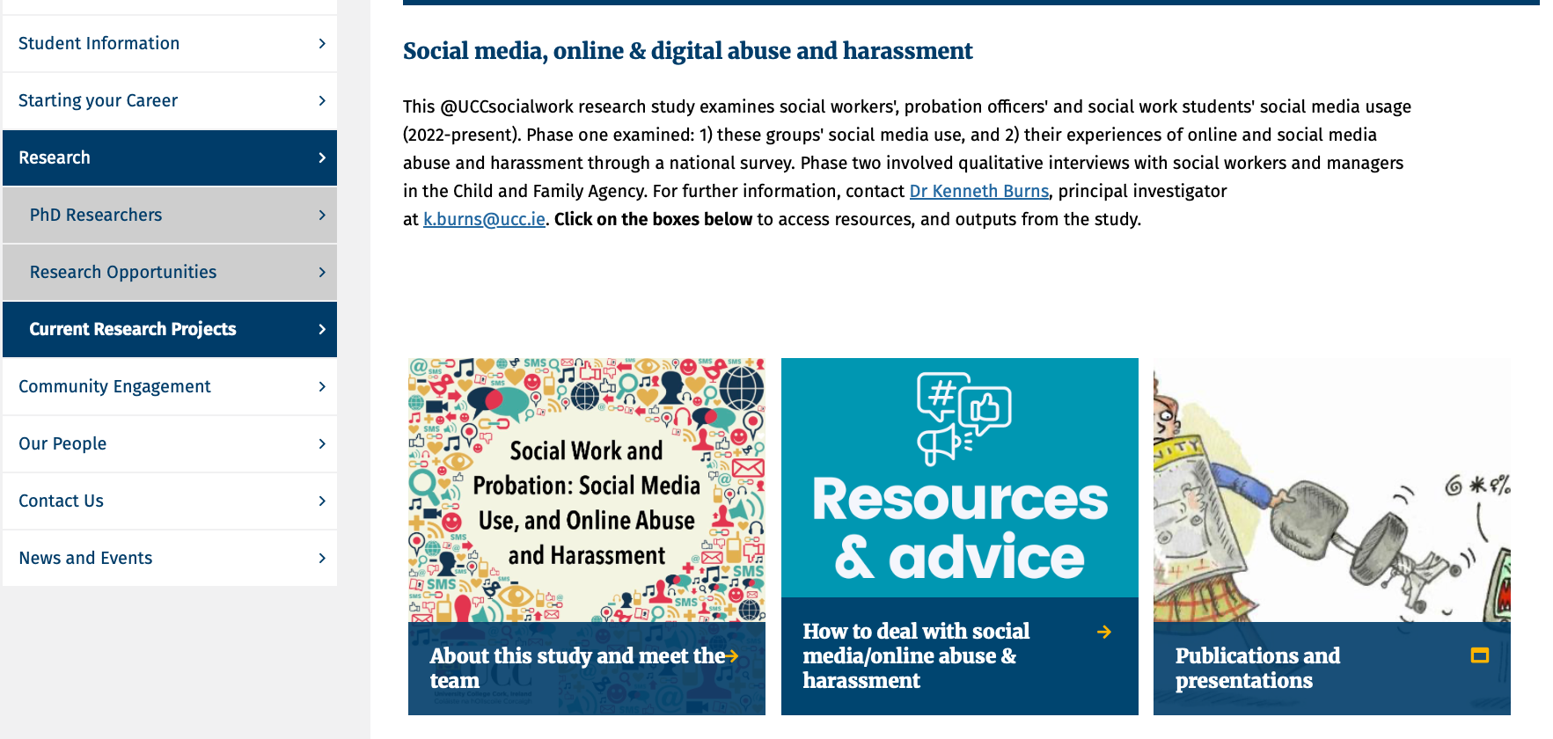
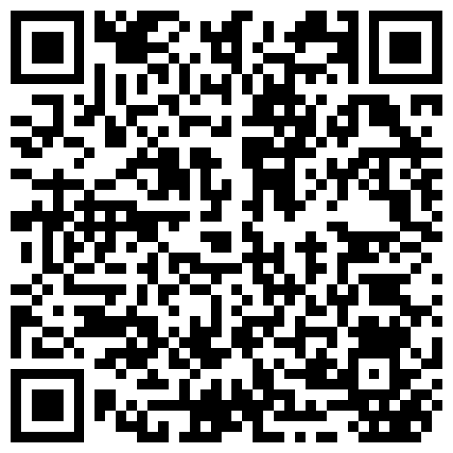

Slide 3


Benefits to Social Media
Downsides to
Social Media
Creating and sharing knowledge
Fostering communities of interest
Establishing and/or maintaining connection
Tools for social change and public debate
Spreading of Disinformation
Cyberbullying
Trolling
Doxxing
Public shaming

Slide 4
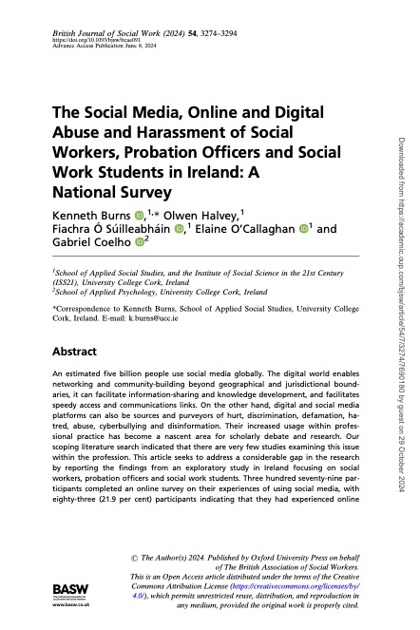
“In our view, the benefits of having social workers, students and probation officers, both in their personal and professional capacities, participating, engaging and being members of social media and online platforms, outweigh the potential negatives”.

Slide 5
“In this paper, we use ‘online and digital abuse and harassment’. By using this term we mean a set of behaviours and practices, whether single or multiple events, by individuals or groups using digital technologies and devices, social media platforms, and/or the internet to send or post direct or implicit messages that are abusive, threatening, or stalking or harassing behaviours of a person. The intention is to cause upset, distress, harm, shame, reputational harm, or to exert pressure to get a desired outcome. It is not confined to a physical workplace, it is generally publicly visible, it can impact more than the intended recipient, and posts are sometimes without attribution (Burns et al., 2024, p. 3291).

Slide 6
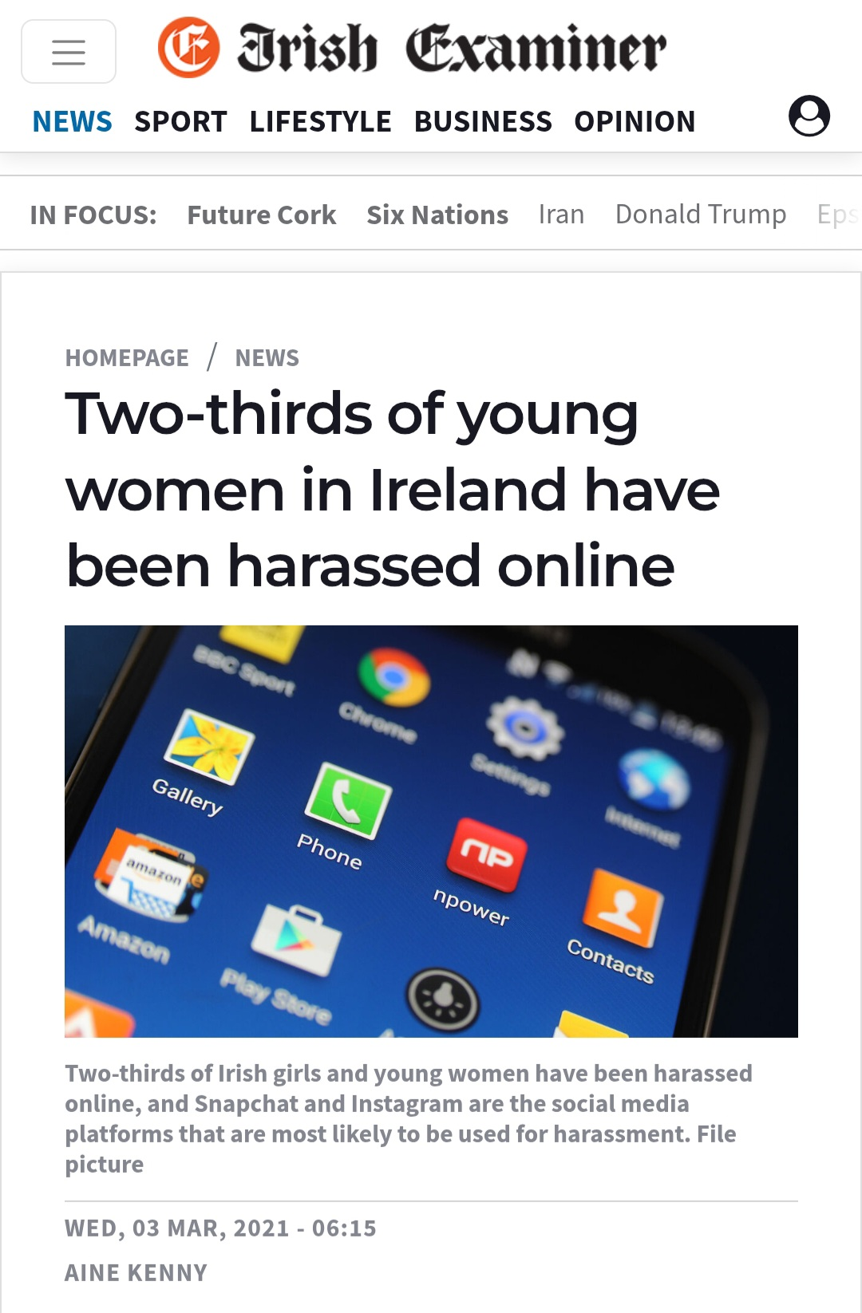
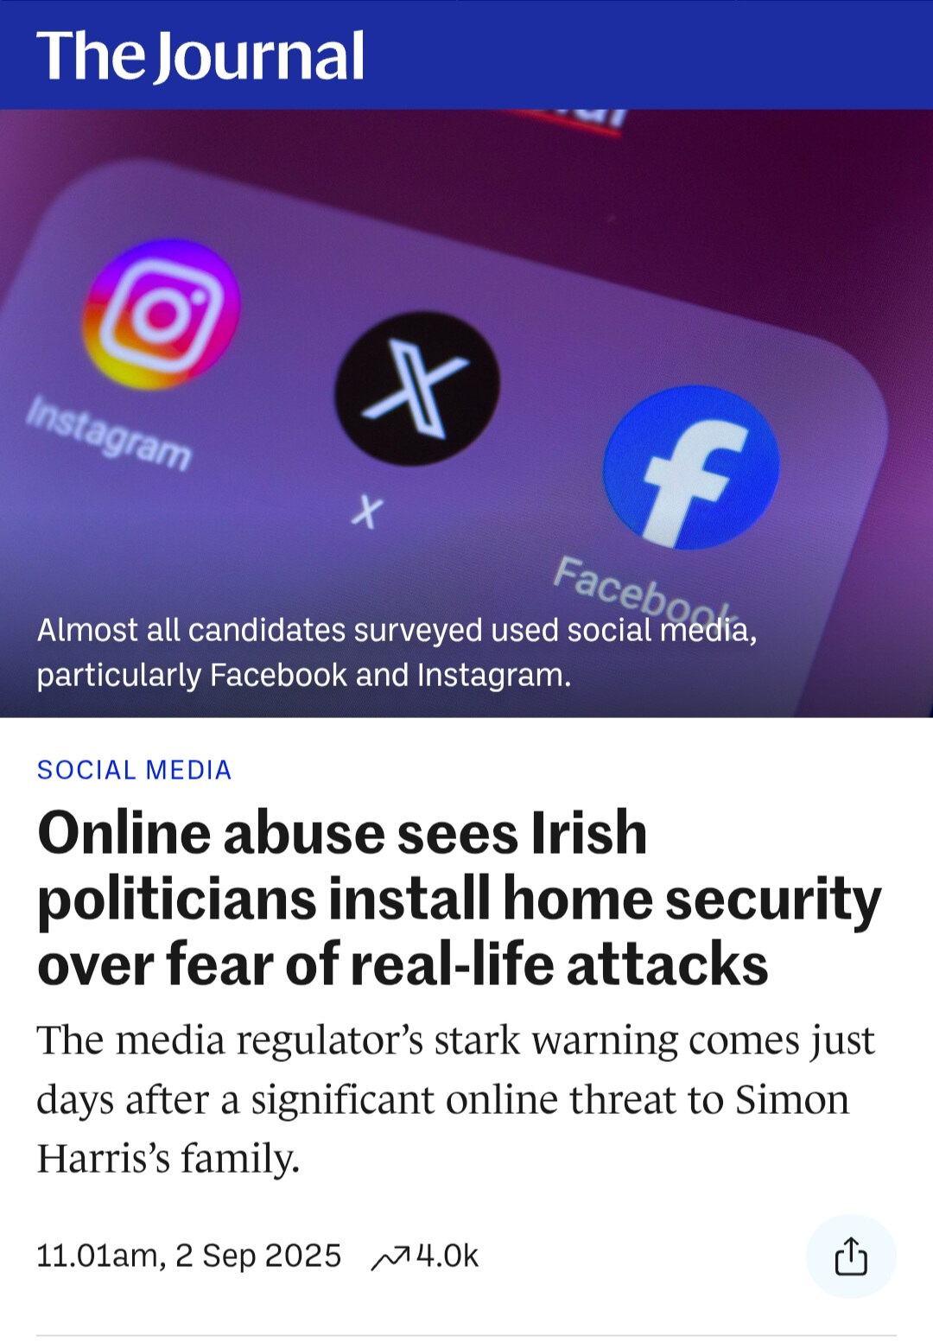
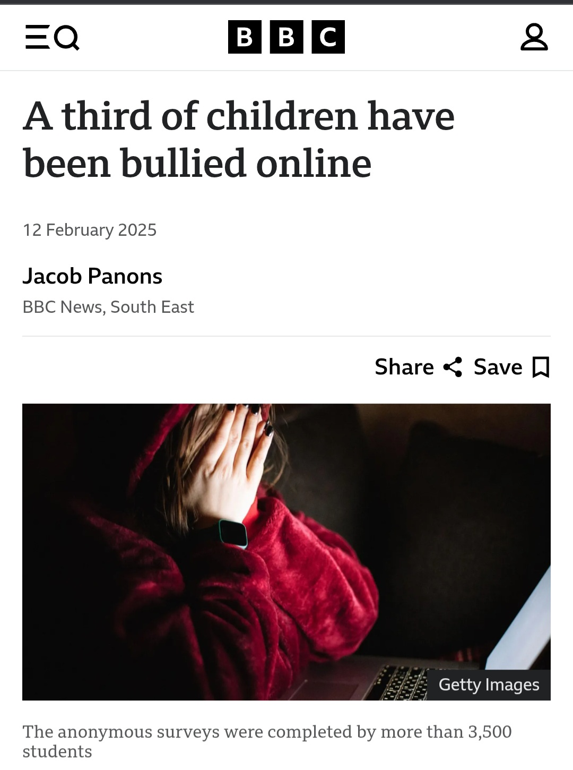
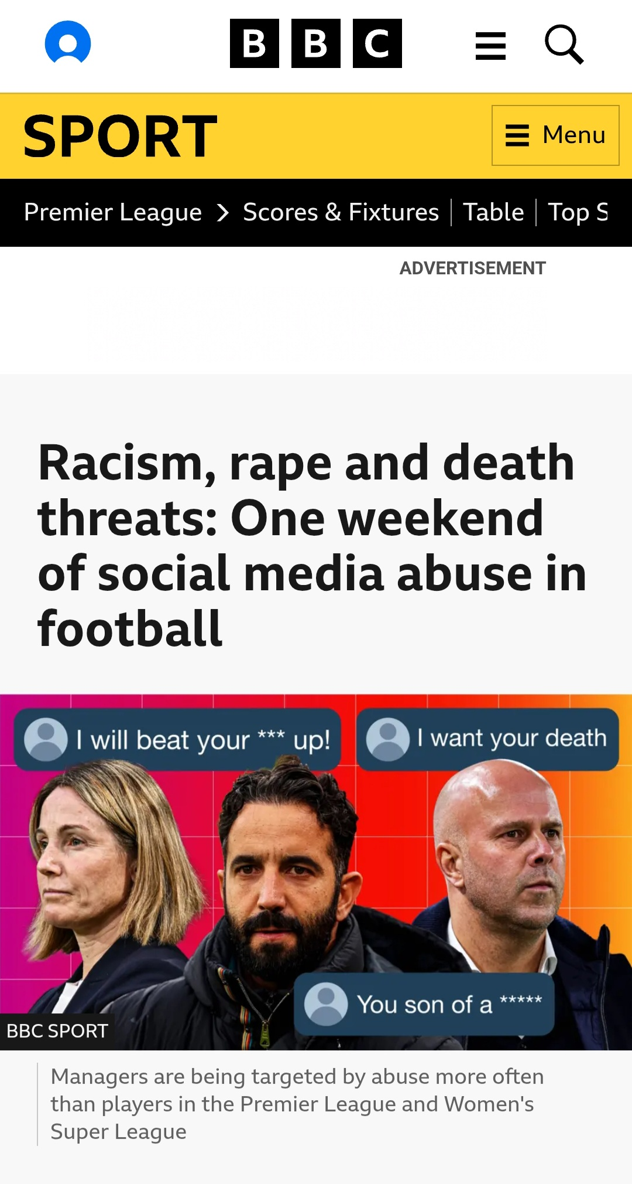
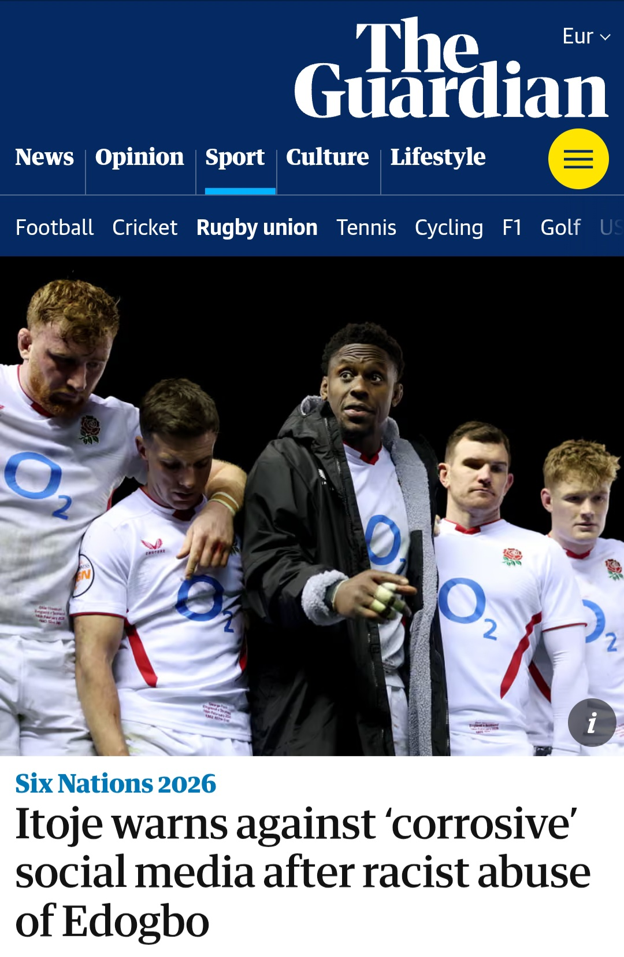
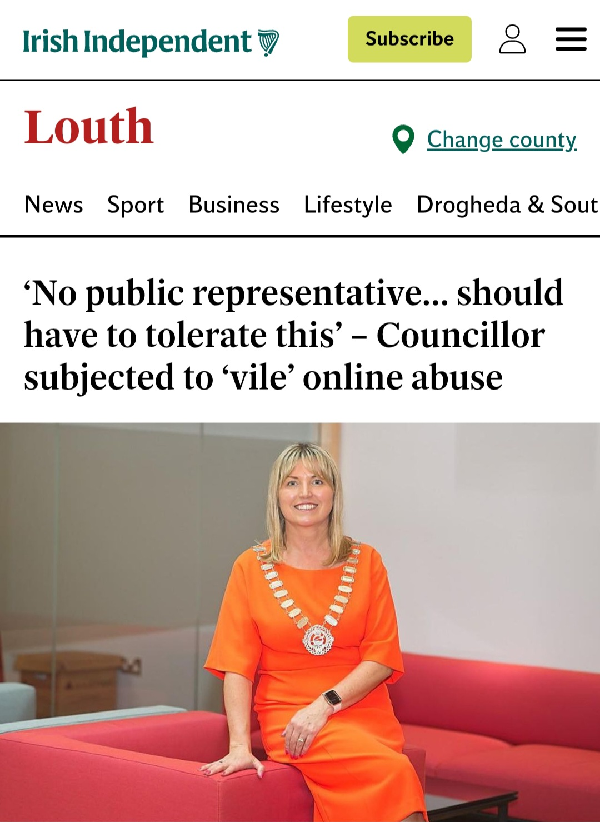
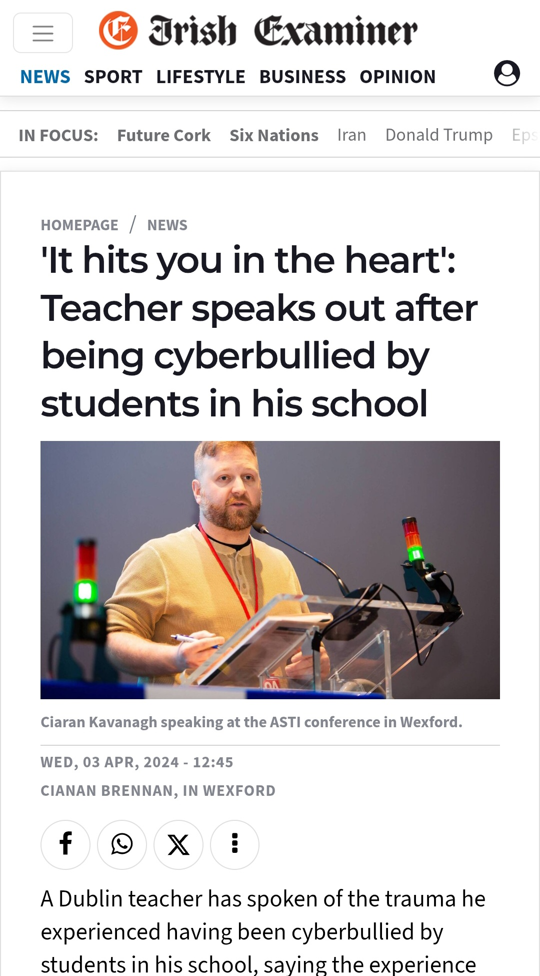

Slide 7

21%

Slide 8

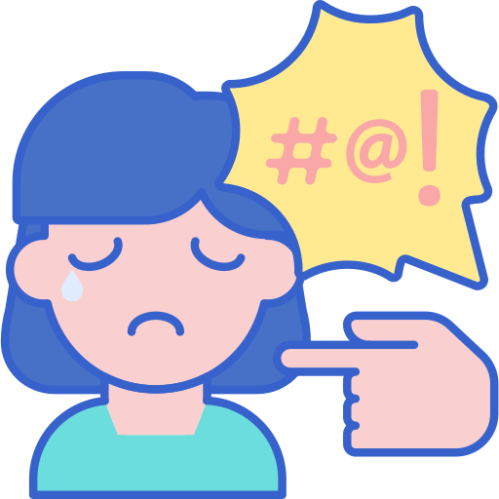


WHAT WE LEARNED IN PHASE 1
92% of social workers use social media
1 in 6 social workers experience social media abuse and online harassment in the course of their work (1 in 5 if you include personal)
Online abuse/harassment occurred even when practitioners exercised discretion and were privacy-aware on social media; you don’t have to be on social media for it to happen
‘It can get under your skin’: impacts were experienced at personal, familial and professional levels. Social workers were often left to individually deal with the online abuse, but participants noted that this has improved over the last few years

Slide 9




WHAT WE LEARNED IN PHASE 2
Facebook was the main platform used for abuse and harassment reported by 18 of the 19 participants.
The parents of children in care or children being supported by the child protection department were most likely to engage in abuse or harassment (11; 8 mothers and 3 fathers)
Experiencing online/social media abuse and harassment, at least for this sample, was not a high-frequency experience for them
Secondary distress could be caused for workers when their employer left them to manage the issue partly, or mostly, on their own.

Slide 10

What happened?

Slide 11
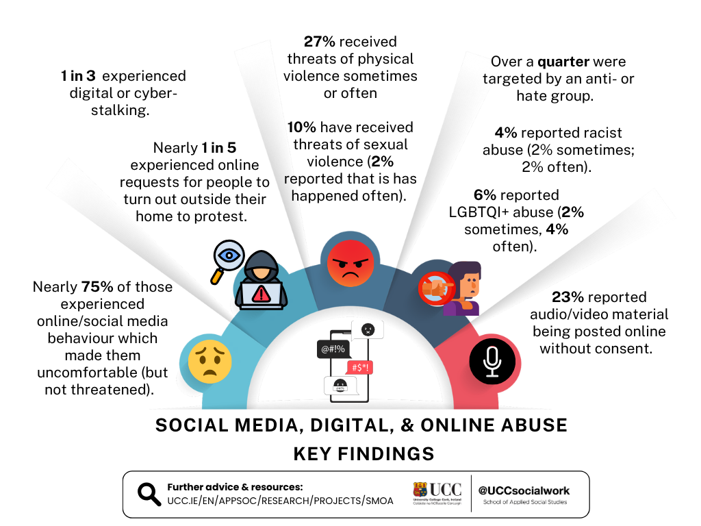

Key Findings Phase 1

Slide 12

What happened?
“… a client...would have set up a fake account using my name, and then would have requested friends of my friends." – Shirley
"And then she posts, started posting on this website called shameyoursocialworkers.com. ......It's an English site. Shameyoursocialworker and she started posting there." Lily
.
Notes:
What happened varies considerably, here are just five accounts which demonstrate this.

Slide 13


What happened?
”… she put up a video on Facebook. It was about 45 minutes long, just a black screen with her talking about how there was a bullet with my name on it." Rachel
”… photographs of my children were put up online." Debby
.
Notes:
Those that we interviewed were very clear as to what online abuse and harassment is, in fact their tolerance and threshold was quite high.....
The first example here is an extreme example which included a death threat, this was in no way followed through on however did result in prosecution.
The second is an example of doxxing, which "is the malicious sharing of documents or personal information online or on social media about a person with malicious intent: to cause embarrassment, to damage their reputation or to exert leverage. Examples include: sharing a professional's home address, phone number, personal information about a professional and /or their family member, or posting private photos (home, children, school)" )Burns, 2021, p.2)

Slide 14
What happened?
Client emailed organisation to say manager was sexually abusing children.
Posted similar messages on Facebook.
Shared allegations with an investigative journalism section of the national broadcaster.
Appeared on a podcast to repeat allegations leading to threats.
Allegations were 100% false.
.
Notes:
What happened varies considerably, here are just five accounts which demonstrate this.

Slide 15
Distinguishing between complaint and abuse
“I'd expect a level of people putting up stuff, maybe not so much identifying who they're dealing with, but saying that, actually, their experience has not been good. But then when it veers in, going: ‘I’ll get you’, like, and that kind of threatening language coming into it. I think that's probably when it crosses the line"
Rachel
.
Notes:
Those that we interviewed were very clear as to what online abuse and harassment is, in fact their tolerance and threshold was quite high.....
"Yeah, I suppose that somebody using your image or your words for their own purpose and against you, really, and to ridicule you and to promote their own interests" Mary
"It gets abusive if there's a sinister aspect to it” Noah

Slide 16


What does a good response look like?

Slide 17
What participants in our study said they needed: a good response
Someone to recognise what was happening as a workplace issue.
Someone to be empathetic, not just follow the policy.
Someone to “have their back” / advocacy / leadership.
Access to legal support, where necessary (takedown requests).
Risk assessment (personal, family, team).
Understanding peers (family usually are not told about it)
Manager/agency do not need to be social media experts to effectively support a staff member.
Notes:
In a digital world, social work services, academics and practitioners need to be technologically proficient in order to maintain disciplinary relevance (Pelez et al. 2021). Our research in phase 1 found that social workers are digitally agile – with 92% of respondents in our sample using social media.
Why is this important?
In terms of the impact of on-line abuse and harassment, Phase 1 tells us that nearly three out of five (57.1%) agreed or strongly agreed that their experiences impacted their sleeping pattern
2 out of 5 (45.4%) agreed or strongly agreed that their mental health was negatively impacted.
Over half (50.9%) agreed or strongly agreed that it negatively affected their professional confidence.
Nearly three out of five (57.1%) agreed or strongly agreed that their experiences impacted their sleeping pattern
2 out of 5 (45.4%) agreed or strongly agreed that their mental health was negatively impacted.
Over half (50.9%) agreed or strongly agreed that it negatively affected their professional confidence.
One in four agreed or strongly agreed that it led them to want to change jobs.
10.7% agreed or strongly agreed that their experiences made them better practitioners.
Over one in three (35.9%) agreed or strongly agreed that their digital practice skills improved as a result of the experience.
86% agreed or strongly agreed that they became more cautious on social media.
One in four agreed or strongly agreed that it led them to want to change jobs.
10.7% agreed or strongly agreed that their experiences made them better practitioners.
Over one in three (35.9%) agreed or strongly agreed that their digital practice skills improved as a result of the experience.
86% agreed or strongly agreed that they became more cautious on social media.

Slide 18
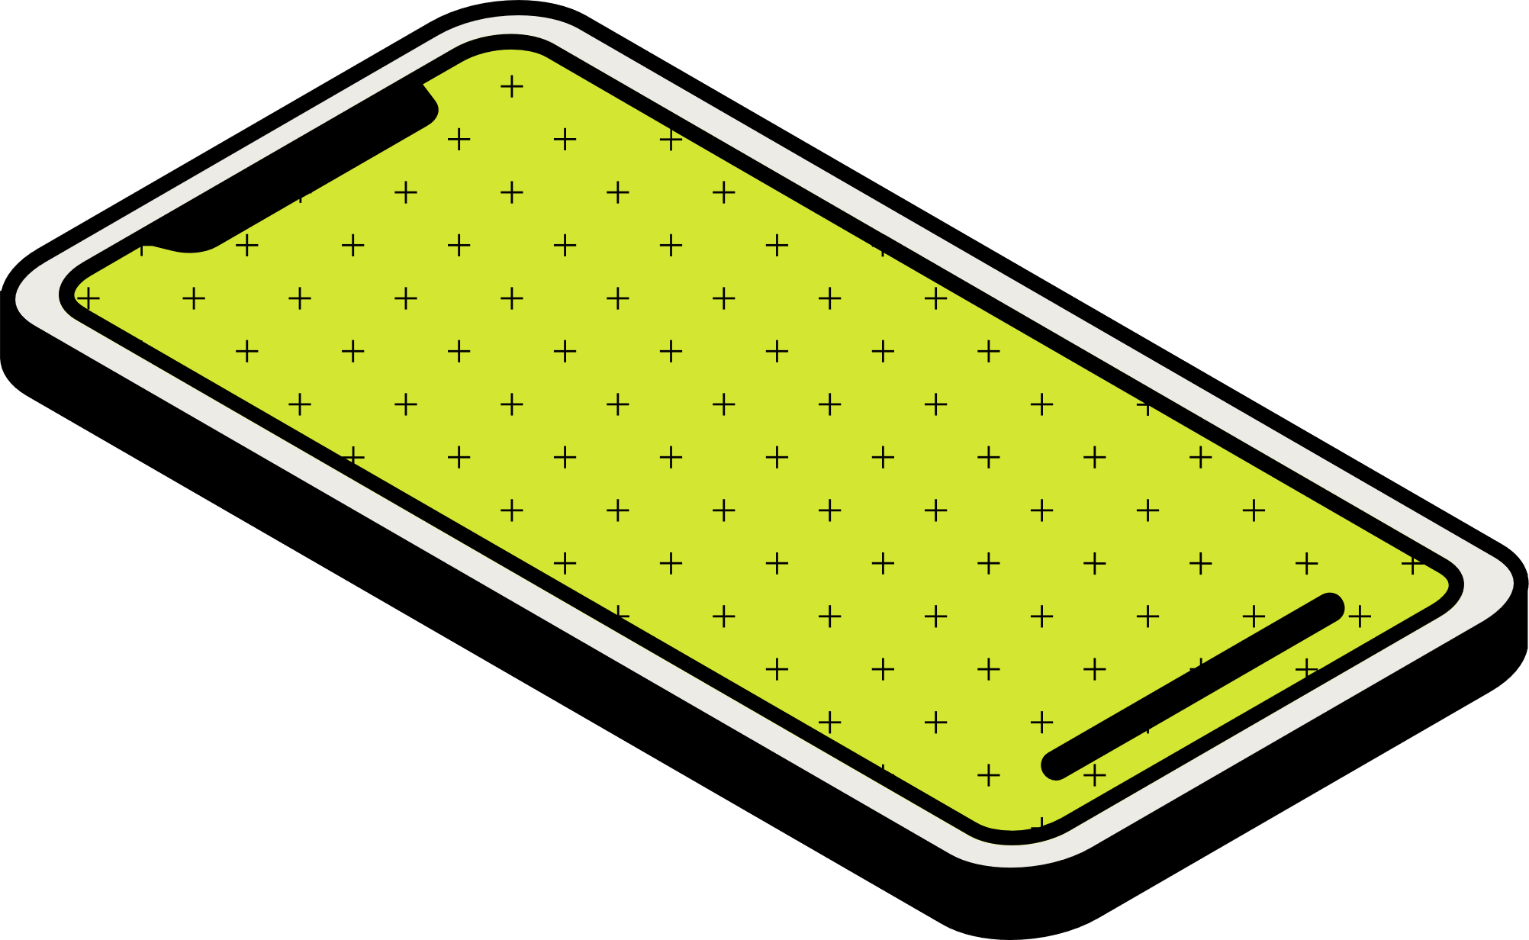

What can I do?

Slide 19
Spring clean exercise
When was the last time you reviewed your social media settings?
What level of privacy / ‘visibility’ are you comfortable with?
What changes do you need to make, if any?
What social media accounts do you manage for community groups / sporting organisations?
I’m not on social media: what has any of this got to do with me?!
Notes:
In a digital world, social work services, academics and practitioners need to be technologically proficient in order to maintain disciplinary relevance (Pelez et al. 2021). Our research in phase 1 found that social workers are digitally agile – with 92% of respondents in our sample using social media.
Why is this important?
In terms of the impact of on-line abuse and harassment, Phase 1 tells us that nearly three out of five (57.1%) agreed or strongly agreed that their experiences impacted their sleeping pattern
2 out of 5 (45.4%) agreed or strongly agreed that their mental health was negatively impacted.
Over half (50.9%) agreed or strongly agreed that it negatively affected their professional confidence.
Nearly three out of five (57.1%) agreed or strongly agreed that their experiences impacted their sleeping pattern
2 out of 5 (45.4%) agreed or strongly agreed that their mental health was negatively impacted.
Over half (50.9%) agreed or strongly agreed that it negatively affected their professional confidence.
One in four agreed or strongly agreed that it led them to want to change jobs.
10.7% agreed or strongly agreed that their experiences made them better practitioners.
Over one in three (35.9%) agreed or strongly agreed that their digital practice skills improved as a result of the experience.
86% agreed or strongly agreed that they became more cautious on social media.
One in four agreed or strongly agreed that it led them to want to change jobs.
10.7% agreed or strongly agreed that their experiences made them better practitioners.
Over one in three (35.9%) agreed or strongly agreed that their digital practice skills improved as a result of the experience.
86% agreed or strongly agreed that they became more cautious on social media.

Slide 20
Spring clean exercise
Ask a friend / family member to search for you
Learn from feedback and review your setting
Repeat the search
If you are not on social media, it is likely that there is still materials up on the web/SM about you
Google search
Search social media apps
Is there any content that could result in your being doxxed?
Put yourself in the shoes of a service user and review the content through their eyes
Notes:
In a digital world, social work services, academics and practitioners need to be technologically proficient in order to maintain disciplinary relevance (Pelez et al. 2021). Our research in phase 1 found that social workers are digitally agile – with 92% of respondents in our sample using social media.
Why is this important?
In terms of the impact of on-line abuse and harassment, Phase 1 tells us that nearly three out of five (57.1%) agreed or strongly agreed that their experiences impacted their sleeping pattern
2 out of 5 (45.4%) agreed or strongly agreed that their mental health was negatively impacted.
Over half (50.9%) agreed or strongly agreed that it negatively affected their professional confidence.
Nearly three out of five (57.1%) agreed or strongly agreed that their experiences impacted their sleeping pattern
2 out of 5 (45.4%) agreed or strongly agreed that their mental health was negatively impacted.
Over half (50.9%) agreed or strongly agreed that it negatively affected their professional confidence.
One in four agreed or strongly agreed that it led them to want to change jobs.
10.7% agreed or strongly agreed that their experiences made them better practitioners.
Over one in three (35.9%) agreed or strongly agreed that their digital practice skills improved as a result of the experience.
86% agreed or strongly agreed that they became more cautious on social media.
One in four agreed or strongly agreed that it led them to want to change jobs.
10.7% agreed or strongly agreed that their experiences made them better practitioners.
Over one in three (35.9%) agreed or strongly agreed that their digital practice skills improved as a result of the experience.
86% agreed or strongly agreed that they became more cautious on social media.

Slide 21
Notes:
In a digital world, social work services, academics and practitioners need to be technologically proficient in order to maintain disciplinary relevance (Pelez et al. 2021). Our research in phase 1 found that social workers are digitally agile – with 92% of respondents in our sample using social media.
Why is this important?
In terms of the impact of on-line abuse and harassment, Phase 1 tells us that nearly three out of five (57.1%) agreed or strongly agreed that their experiences impacted their sleeping pattern
2 out of 5 (45.4%) agreed or strongly agreed that their mental health was negatively impacted.
Over half (50.9%) agreed or strongly agreed that it negatively affected their professional confidence.
Nearly three out of five (57.1%) agreed or strongly agreed that their experiences impacted their sleeping pattern
2 out of 5 (45.4%) agreed or strongly agreed that their mental health was negatively impacted.
Over half (50.9%) agreed or strongly agreed that it negatively affected their professional confidence.
One in four agreed or strongly agreed that it led them to want to change jobs.
10.7% agreed or strongly agreed that their experiences made them better practitioners.
Over one in three (35.9%) agreed or strongly agreed that their digital practice skills improved as a result of the experience.
86% agreed or strongly agreed that they became more cautious on social media.
One in four agreed or strongly agreed that it led them to want to change jobs.
10.7% agreed or strongly agreed that their experiences made them better practitioners.
Over one in three (35.9%) agreed or strongly agreed that their digital practice skills improved as a result of the experience.
86% agreed or strongly agreed that they became more cautious on social media.

Slide 22
Notes:
In a digital world, social work services, academics and practitioners need to be technologically proficient in order to maintain disciplinary relevance (Pelez et al. 2021). Our research in phase 1 found that social workers are digitally agile – with 92% of respondents in our sample using social media.
Why is this important?
In terms of the impact of on-line abuse and harassment, Phase 1 tells us that nearly three out of five (57.1%) agreed or strongly agreed that their experiences impacted their sleeping pattern
2 out of 5 (45.4%) agreed or strongly agreed that their mental health was negatively impacted.
Over half (50.9%) agreed or strongly agreed that it negatively affected their professional confidence.
Nearly three out of five (57.1%) agreed or strongly agreed that their experiences impacted their sleeping pattern
2 out of 5 (45.4%) agreed or strongly agreed that their mental health was negatively impacted.
Over half (50.9%) agreed or strongly agreed that it negatively affected their professional confidence.
One in four agreed or strongly agreed that it led them to want to change jobs.
10.7% agreed or strongly agreed that their experiences made them better practitioners.
Over one in three (35.9%) agreed or strongly agreed that their digital practice skills improved as a result of the experience.
86% agreed or strongly agreed that they became more cautious on social media.
One in four agreed or strongly agreed that it led them to want to change jobs.
10.7% agreed or strongly agreed that their experiences made them better practitioners.
Over one in three (35.9%) agreed or strongly agreed that their digital practice skills improved as a result of the experience.
86% agreed or strongly agreed that they became more cautious on social media.

Slide 24
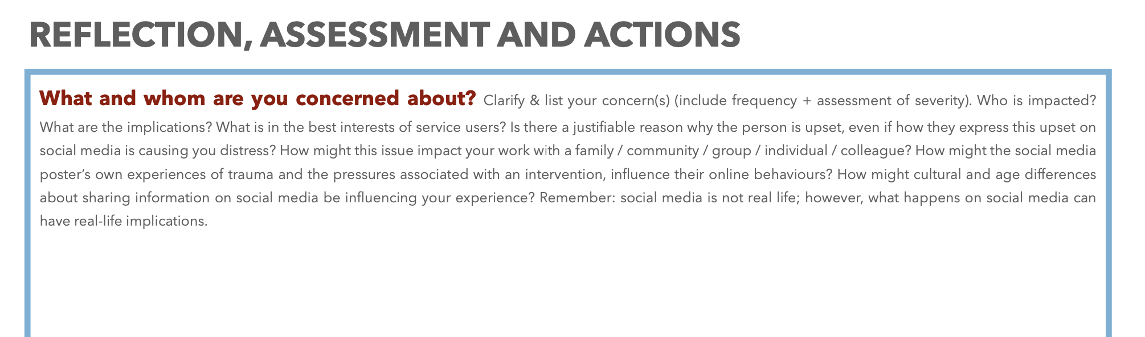

Slide 25
What to do – suggested actions
1 | Work or personal? If work, it is not your sole responsibility
2 | Document the concern with relevant details, including screenshots, links, dates, and time.
3 | Report the issue to your immediate supervisor / manager.
4 | Do not respond / engage
5 | What are the potential risks to you, clients, family members? (safety, reputation, harm, community, relationships)
6 | What immediate/medium term actions could be helpful? (court order, take down requests, reporting, mute, blocking, police, etc.)
7 | Follow the advice in your social media policy
8 | Engage supports (team, personal, family)
9 | Self-care strategies

Slide 28
Accountability and regulations
1. Europe / UK model higher regulation / move towards accountability (e.g. Digital Service Act 2024)
vs.
2. US light regulation model / low accountability & antagonistic towards countries that are seeking to regulate social media companies

Slide 29
Notes:
In a digital world, social work services, academics and practitioners need to be technologically proficient in order to maintain disciplinary relevance (Pelez et al. 2021). Our research in phase 1 found that social workers are digitally agile – with 92% of respondents in our sample using social media.
Why is this important?
In terms of the impact of on-line abuse and harassment, Phase 1 tells us that nearly three out of five (57.1%) agreed or strongly agreed that their experiences impacted their sleeping pattern
2 out of 5 (45.4%) agreed or strongly agreed that their mental health was negatively impacted.
Over half (50.9%) agreed or strongly agreed that it negatively affected their professional confidence.
Nearly three out of five (57.1%) agreed or strongly agreed that their experiences impacted their sleeping pattern
2 out of 5 (45.4%) agreed or strongly agreed that their mental health was negatively impacted.
Over half (50.9%) agreed or strongly agreed that it negatively affected their professional confidence.
One in four agreed or strongly agreed that it led them to want to change jobs.
10.7% agreed or strongly agreed that their experiences made them better practitioners.
Over one in three (35.9%) agreed or strongly agreed that their digital practice skills improved as a result of the experience.
86% agreed or strongly agreed that they became more cautious on social media.
One in four agreed or strongly agreed that it led them to want to change jobs.
10.7% agreed or strongly agreed that their experiences made them better practitioners.
Over one in three (35.9%) agreed or strongly agreed that their digital practice skills improved as a result of the experience.
86% agreed or strongly agreed that they became more cautious on social media.

Slide 30
Notes:
In a digital world, social work services, academics and practitioners need to be technologically proficient in order to maintain disciplinary relevance (Pelez et al. 2021). Our research in phase 1 found that social workers are digitally agile – with 92% of respondents in our sample using social media.
Why is this important?
In terms of the impact of on-line abuse and harassment, Phase 1 tells us that nearly three out of five (57.1%) agreed or strongly agreed that their experiences impacted their sleeping pattern
2 out of 5 (45.4%) agreed or strongly agreed that their mental health was negatively impacted.
Over half (50.9%) agreed or strongly agreed that it negatively affected their professional confidence.
Nearly three out of five (57.1%) agreed or strongly agreed that their experiences impacted their sleeping pattern
2 out of 5 (45.4%) agreed or strongly agreed that their mental health was negatively impacted.
Over half (50.9%) agreed or strongly agreed that it negatively affected their professional confidence.
One in four agreed or strongly agreed that it led them to want to change jobs.
10.7% agreed or strongly agreed that their experiences made them better practitioners.
Over one in three (35.9%) agreed or strongly agreed that their digital practice skills improved as a result of the experience.
86% agreed or strongly agreed that they became more cautious on social media.
One in four agreed or strongly agreed that it led them to want to change jobs.
10.7% agreed or strongly agreed that their experiences made them better practitioners.
Over one in three (35.9%) agreed or strongly agreed that their digital practice skills improved as a result of the experience.
86% agreed or strongly agreed that they became more cautious on social media.

Slide 31
Notes:
In a digital world, social work services, academics and practitioners need to be technologically proficient in order to maintain disciplinary relevance (Pelez et al. 2021). Our research in phase 1 found that social workers are digitally agile – with 92% of respondents in our sample using social media.
Why is this important?
In terms of the impact of on-line abuse and harassment, Phase 1 tells us that nearly three out of five (57.1%) agreed or strongly agreed that their experiences impacted their sleeping pattern
2 out of 5 (45.4%) agreed or strongly agreed that their mental health was negatively impacted.
Over half (50.9%) agreed or strongly agreed that it negatively affected their professional confidence.
Nearly three out of five (57.1%) agreed or strongly agreed that their experiences impacted their sleeping pattern
2 out of 5 (45.4%) agreed or strongly agreed that their mental health was negatively impacted.
Over half (50.9%) agreed or strongly agreed that it negatively affected their professional confidence.
One in four agreed or strongly agreed that it led them to want to change jobs.
10.7% agreed or strongly agreed that their experiences made them better practitioners.
Over one in three (35.9%) agreed or strongly agreed that their digital practice skills improved as a result of the experience.
86% agreed or strongly agreed that they became more cautious on social media.
One in four agreed or strongly agreed that it led them to want to change jobs.
10.7% agreed or strongly agreed that their experiences made them better practitioners.
Over one in three (35.9%) agreed or strongly agreed that their digital practice skills improved as a result of the experience.
86% agreed or strongly agreed that they became more cautious on social media.

Slide 32
Notes:
In a digital world, social work services, academics and practitioners need to be technologically proficient in order to maintain disciplinary relevance (Pelez et al. 2021). Our research in phase 1 found that social workers are digitally agile – with 92% of respondents in our sample using social media.
Why is this important?
In terms of the impact of on-line abuse and harassment, Phase 1 tells us that nearly three out of five (57.1%) agreed or strongly agreed that their experiences impacted their sleeping pattern
2 out of 5 (45.4%) agreed or strongly agreed that their mental health was negatively impacted.
Over half (50.9%) agreed or strongly agreed that it negatively affected their professional confidence.
Nearly three out of five (57.1%) agreed or strongly agreed that their experiences impacted their sleeping pattern
2 out of 5 (45.4%) agreed or strongly agreed that their mental health was negatively impacted.
Over half (50.9%) agreed or strongly agreed that it negatively affected their professional confidence.
One in four agreed or strongly agreed that it led them to want to change jobs.
10.7% agreed or strongly agreed that their experiences made them better practitioners.
Over one in three (35.9%) agreed or strongly agreed that their digital practice skills improved as a result of the experience.
86% agreed or strongly agreed that they became more cautious on social media.
One in four agreed or strongly agreed that it led them to want to change jobs.
10.7% agreed or strongly agreed that their experiences made them better practitioners.
Over one in three (35.9%) agreed or strongly agreed that their digital practice skills improved as a result of the experience.
86% agreed or strongly agreed that they became more cautious on social media.

Slide 33
Notes:
In a digital world, social work services, academics and practitioners need to be technologically proficient in order to maintain disciplinary relevance (Pelez et al. 2021). Our research in phase 1 found that social workers are digitally agile – with 92% of respondents in our sample using social media.
Why is this important?
In terms of the impact of on-line abuse and harassment, Phase 1 tells us that nearly three out of five (57.1%) agreed or strongly agreed that their experiences impacted their sleeping pattern
2 out of 5 (45.4%) agreed or strongly agreed that their mental health was negatively impacted.
Over half (50.9%) agreed or strongly agreed that it negatively affected their professional confidence.
Nearly three out of five (57.1%) agreed or strongly agreed that their experiences impacted their sleeping pattern
2 out of 5 (45.4%) agreed or strongly agreed that their mental health was negatively impacted.
Over half (50.9%) agreed or strongly agreed that it negatively affected their professional confidence.
One in four agreed or strongly agreed that it led them to want to change jobs.
10.7% agreed or strongly agreed that their experiences made them better practitioners.
Over one in three (35.9%) agreed or strongly agreed that their digital practice skills improved as a result of the experience.
86% agreed or strongly agreed that they became more cautious on social media.
One in four agreed or strongly agreed that it led them to want to change jobs.
10.7% agreed or strongly agreed that their experiences made them better practitioners.
Over one in three (35.9%) agreed or strongly agreed that their digital practice skills improved as a result of the experience.
86% agreed or strongly agreed that they became more cautious on social media.

Slide 35
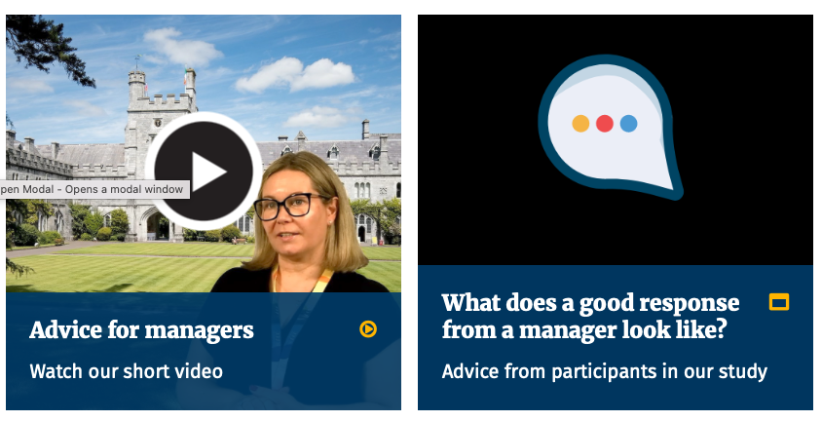


Slide 36
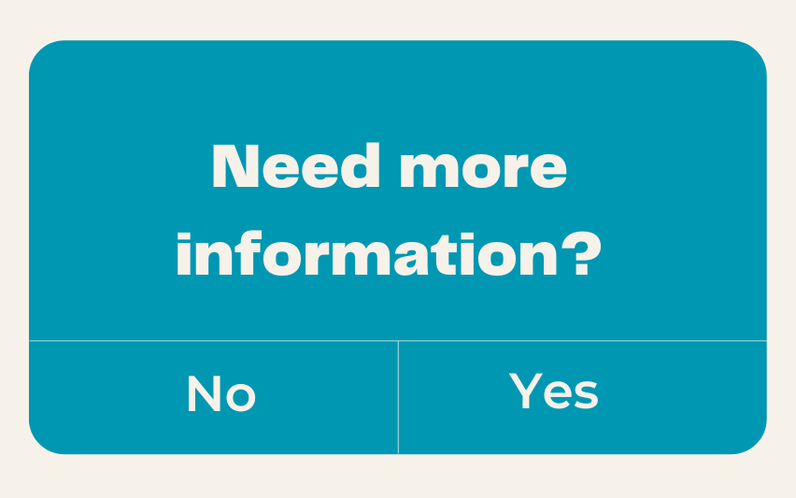
Dr Kenneth Burns, Olwen Halvey,
Dr Fiachra Ó Súilleabháin and Amy Bradley
k.burns@ucc.ie

